Slide 1
The Importance of Appearance and Grooming
Key vocabulary
Look them up in the dictionary
Decorum
Disposition
Etiquette
Grooming
Hues
Kempt
Lather
Odour
Scruffy
Stylish
Social grooming

Slide 2
What is Appearance and Grooming?
• Appearance: How we look, dress, and present ourselves.
• Grooming: The care and cleanliness of our bodies and clothing.
• Why It Matters: First impressions, self-confidence, and respect for self and others.

Slide 3
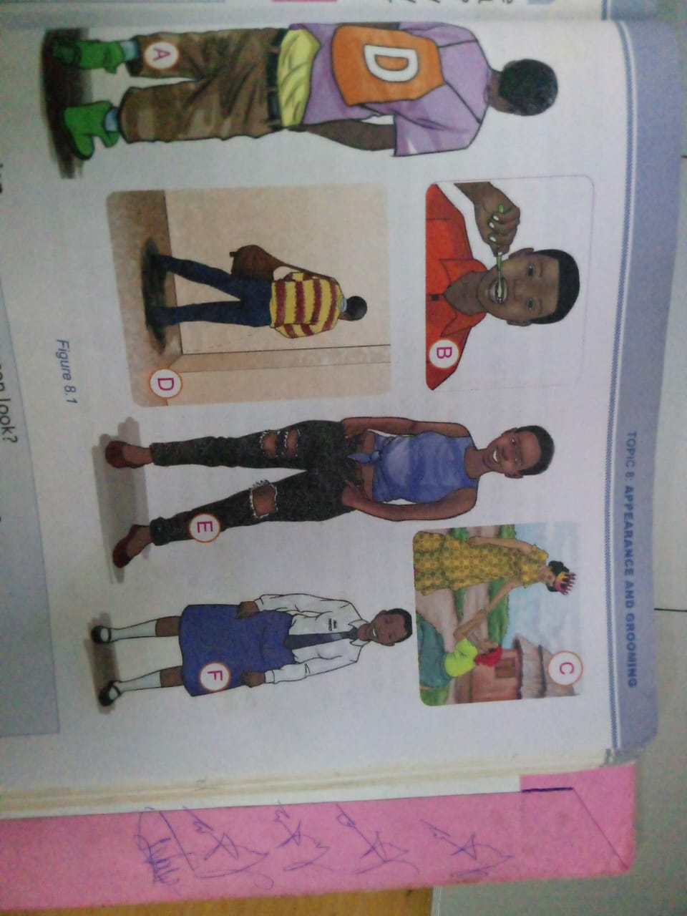
Compare and appreciate
Which one represents bad and good grooming?

Slide 4
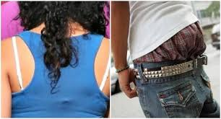
Compare and appreciate
Comment on this appearance.

Slide 5
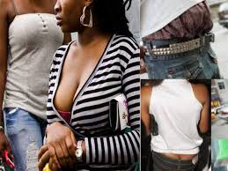
Compare and appreciate
Comment on this appearance.

Slide 6
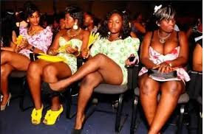
Compare and appreciate
Comment on this appearance.

Slide 7
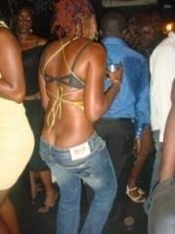
Compare and appreciate
Comment on this appearance.

Slide 8
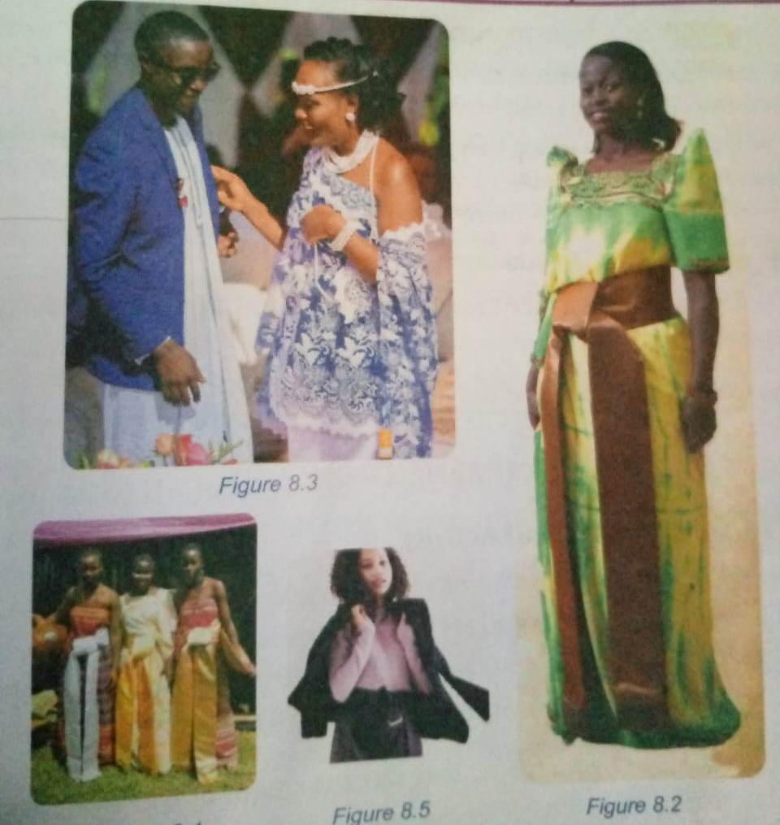

Slide 9

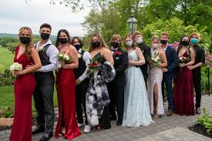
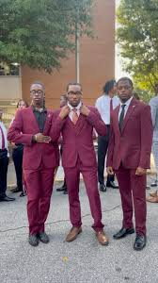


Slide 10
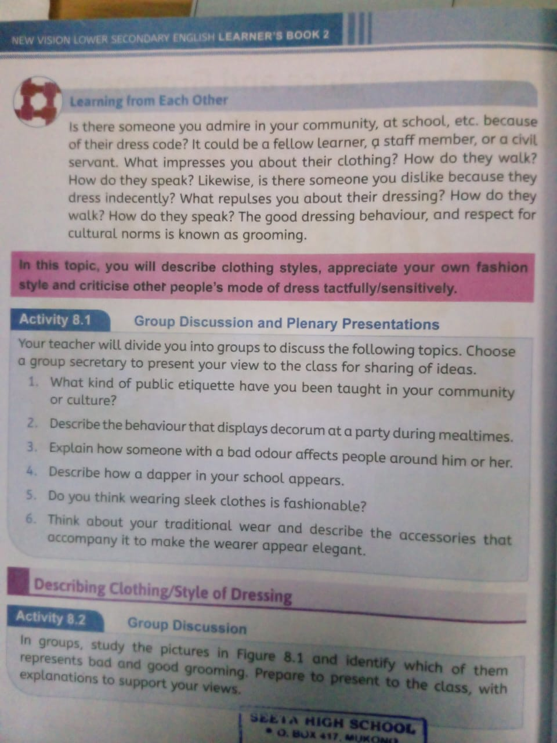

Slide 11
Presentation time
Write what you don’t have in your group

Slide 12
Discussion
Basing on the above images, discuss in triads what good practice about grooming and appearance should be. You have 8 minutes

Slide 13
Why is Grooming Important?
Builds self-confidence.
Reflects personal hygiene and self-respect.
Impacts how others view and interact with us.
Helps us stay healthy and presentable in social and academic settings.

Slide 14
Elements of Good Appearance and Grooming
• Clothing: Clean, appropriate, and well-fitted.
• Hair Care: Clean, neat, and styled.
• Oral Hygiene: Brushing, flossing, and fresh breath.
• Skin Care: Washing face, using lotion, and caring for any skin issues.

Slide 15
Daily Grooming Routine for Students
• Morning Routine: Shower, brush teeth, comb hair, apply deodorant.
• After-School Routine: Change clothes, clean up after activities.
• Before Bed Routine: Wash face, brush teeth, prepare uniform for the next day.
• Tip: Consistency is key in maintaining good grooming habits.

Slide 16
Appropriate School Attire
• Uniform: Wear it neatly and keep it clean.
• Shoes: Keep them polished and well-maintained.
• Accessories: Minimize jewelry and maintain a simple look.

Slide 17
Personal Hygiene Tips
• Handwashing: Before meals, after using the toilet, and after sports.
• Nail Care: Keep nails trimmed and clean.
• Sweat Control: Use deodorant, especially during warm seasons.

Slide 18
Benefits of Good Grooming
• Self-Esteem: Feeling good about how you look.
• Respect from Others: Positive interactions with peers and teachers.
• Better Health: Reduces risk of infections and illnesses.

Slide 19
Handling Common Grooming Challenges
• Limited water or resources? Use wet wipes and carry deodorant.
• Busy schedule? Create a routine and prepare the night before.
• Skin issues? Seek help from a trusted adult or use basic skincare.
• Tip: Simple solutions can help maintain grooming even on busy days.

Slide 20
The Role of Appearance in Achieving Goals
• Looking good can open doors in both academics and social life.
• Good grooming habits can prepare students for future responsibilities and job readiness.
• Being well-groomed can improve focus and productivity.

Slide 21
Remember: Grooming is Self-Respect
• Good grooming is important for self-esteem, health, and social interactions.
• Developing a routine makes grooming easy and manageable.
• Look Good, Feel Good!

